Slide 1
MCAS Competency Determination and its Implications for Higher Education
John papay
Brown university
February 2020

Slide 2
Using integrated data to examine policy problems
Critical problem
Our evidence so far
MA public school students who grow up in low-income families go on to earn much less than peers who grow up in higher-income families.
High school MCAS scores reflect academic skills that pay off in the labor market
There are substantial gaps in educational attainments, even among students with similar academic skills
Skill and educational attainment gaps account for most of the earnings gap
Our question
Do academic skills and/or educational attainments account for these earnings gaps?

Slide 3





There is substantial (and growing) inequality in the family incomes of children attending Massachusetts public schools
This family income inequality contributes to factors including:
$
Parental spending gaps
Residential segregation
School segregation
This inequality dramatically increases the challenges facing MA’s PK-20 public education system

Slide 4
Existing data systems have allowed us to analyze certain aspects of this question
% Meets/Exceeds Expectations (2019)
% Enroll in College*
Higher income
Low income
Higher income
Low income
This evidence is suggestive, but piecemeal. Integrating datasets over time and across agencies enables much more nuanced answers to inform policy
* Enrollment in two- or four-year college four years post MCAS, among 2015 first-time 10th grade test takers

Slide 5



Integrated, longitudinal data allows for much more nuanced and detailed analysis
High School
College/Work
Workforce
Student from higher income family
$49,888
Student from lower income family
$35,909
Age 16 18 20 22 24 26 28 30 32
2003
MCAS
2019
How can this dataset inform our policy problem?
Do academic skills and/or educational attainments account for these large earnings gaps for students who grew up in higher- and low-income families?

Slide 6
High school MCAS scores reflect academic skills that pay off in the labor market

Slide 7
MCAS scores reflect academic skills that pay off in the labor market
We look at median annual earnings ~ age 30 for students at each MCAS score
Students with higher MCAS scores go on to earn substantially more in the labor market.
NOTE: We only observe in-state earnings reported to the UI system. This excludes self-employed individuals or those who work for the federal government or military. Living Wage from MIT estimates for two working parents with two children.

Slide 8
MCAS scores reflect academic skills that pay off in the labor market
We look at median annual earnings ~ age 30 for students at each MCAS score
Students with higher MCAS scores go on to earn substantially more in the labor market.
Is this simply because students with higher MCAS scores tend to go to college, or because they have different demographic profiles?
75th Percentile
25th Percentile
NOTE: We only observe in-state earnings reported to the UI system. This excludes self-employed individuals or those who work for the federal government or military. Living Wage from MIT estimates for two working parents with two children.

Slide 9
MCAS scores predict educational attainments
Steep relationship between MCAS scores and attainments.
Only 19% of students scoring at the 25th percentile in 2003-05 graduate from a four-year college (within 7 years of taking the test), compared to nearly 67% of students scoring at the 75th percentile.
NOTE: We measure HS graduation within 3 years of taking the 10th grade test, college attendance within 4 years, and college graduation within 7 years.

Slide 10
MCAS scores predict earnings even if we compare students with the same educational attainments and demographics
We compare students with similar demographics from the same high school.
There are large financial returns to MCAS scores for students with similar attainments.
Earnings Premium Associated with MCAS Scores
Four-Year College Graduates*
+14%
-11%
-20%
*We look at FY2019 earnings for first-time 10th grade test takers in 2003-05.
N: Failing=888; NI=8,402; P=20,904; A=37,317.

Slide 11
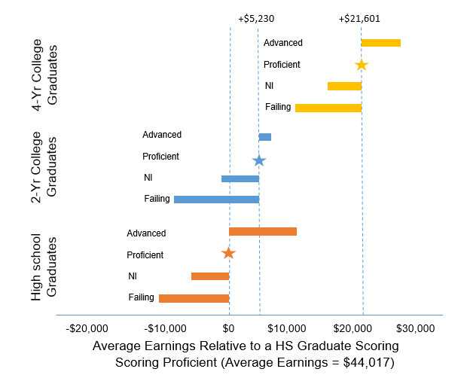
MCAS scores predict earnings even if we compare students with the same educational attainments and demographics
We see similar patterns across all levels of attainment.
We see strong financial returns to educational attainments (particularly four-year college degrees) for students at the same MCAS score level.
11
*We look at FY2019 earnings for first-time 10th grade test takers in 2003-05. 4-yr College Graduates N: Failing=888; NI=8,402; P=20,904; A=37,317. 2-yr HS Graduates N: Failing=583; NI=1,843; P=1,515; A=466. Terminal HS Graduates N: Failing=8,507; NI=14,943; P=9,172; A=5,395.

Slide 12


Improvements in skills reflected in MCAS score improvements between 8th and 10th grade predict longer-term outcomes
We compare students with similar 8th grade MCAS scores
Those who have higher 10th grade MCAS scores go on to earn more ~15 years later
$$
$
8th Grade
MCAS
10th Grade
MCAS
Age 30
Earnings
Among students with similar 8th grade scores, scoring 1 SD higher in 10th grade is associated with a 12% difference in later earnings.

Slide 13
There are substantial gaps in educational attainments, even among students with similar academic skills

Slide 14

Among MA public high school graduates, 30% of low-income students first enroll in a 4-year college (vs. 60% for higher-income students)
No college
2yr – MA public
2yr – Other
4yr – MA public
4yr – Other
$
Low Income
42%
26%
1%
13%
17%
N = 32,343
$$$
Non-low Income
22%
17%
1%
20%
40%
N = 143,841
*Among MA public high school graduates who took 10th grade MCAS (2003-05).
Notes:
14

Slide 15
Among low-income students who enter a two-year college shortly after high school, almost 80% have no credential 5 years later.
Among students who first enter MA public 4-yr college
$
Graduate (within 7 years of MCAS)
48%
Among students who first enter MA public 2-yr college
Low Income
Graduate, do not transfer to 4yr
20%
Graduate, transfer to 4yr, and graduate
.1%
Graduate, transfer to 4yr, but no degree
.3%
N = 32,343
Transfer to 4yr and graduate
.9%
Transfer to 4yr but no degree
3%
Among students who first enter MA public 4-yr college
$$$
Graduate (within 7 years of MCAS)
63%
Among students who first enter MA public 2-yr college
Non-low Income
Graduate, do not transfer to 4yr
26%
Graduate, transfer to 4yr, and graduate
.2%
Graduate, transfer to 4yr, but no degree
.6%
N = 143,841
Transfer to 4yr and graduate
3%
Transfer to 4yr but no degree
4%
Notes:
15

Slide 16
There are striking gaps in 4-year college completion by family income, even among students with similar MCAS scores
At the median MCAS score, higher-income students are 21 percentage points more likely to graduate from a 4-year college than low-income students.

Slide 17
Income-based gaps in completion exist for students who enroll at Massachusetts public four-year universities
Among students who enroll at MA public four-year universities, students who grew up in low-income families are much less likely to graduate than their peers with the same MCAS scores who grew up in higher-income families.

Slide 18
Skill and educational attainment gaps account for most of the earnings gap

Slide 19
Comparing students with the same MCAS scores and attainments, earnings gaps are quite small
Four-year college graduates from low-income families have similar later earnings as higher-income college graduates with the same MCAS math scores.
This pattern holds for graduates of MA public 4-year colleges.
Note: data from MCAS, SIMS, NSC college-going records, and DUA wage records

Slide 20
Comparing students with the same MCAS scores and attainments, earnings gaps are quite small
We see similar patterns across lines of difference in the Commonwealth.
Comparison for 2003-05 test-takers | Overall Gap in 2019 earnings | Gap conditional on MCAS scores and attainment
Low-income (vs. higher income) | -31% (-$15,000) | -7% (-$3,500)
Black (vs. non-Hispanic white) | -31% (-$15,000) | -9% (-$4,500)
Hispanic (vs. non-Hispanic white) | -28% (-$14,000) | 1.1% (+$500)
English Learner (in grade 10) vs. Non-EL | -16% (-$10,000) | +18% ($2,650)

Slide 21
Educational attainments are rising for all groups, but gaps in four-year college attainment rate are widening
Educational attainments are rising for all groups, but gaps in four-year college attainment rate appear to be widening
Educational attainments have risen for all groups
Gaps in high-school graduation have narrowed from 18 to 10% points.
Gaps in 4-year college attainment have grown from 28 to 35% points.
Similar patterns across other lines of difference.

Slide 22
Summary and next steps
Summary
  High school MCAS scores reflect academic skills that pay off in the labor market
  There are substantial income-based gaps in educational attainments, even among students with similar academic skills
  Skill and educational attainment gaps account for most of the disparity in later average earnings
  Income-based gaps in HS completion are narrowing, but gaps in 4-year college completion are growing.
Next steps
  Additional evidence to inform competency determination policy (DESE)
  Analysis of time to completion and labor market returns to MA community colleges

Slide 23
Appendix

Slide 24
These gaps not only reflect gaps in enrollment, but gaps in completion for students who do enroll in a 4-year college
Among students who t the median MCAS score, higher-income students are 21 percentage points more likely to graduate from a 4-year college than low-income students.

